Slide 1

Docker Monitoring & Logging - Day 3 (Conceptual & Architectural)

Slide 2
Contents
1.
Agenda
2.
Monitoring Containers
3.
Logging Strategies with Docker
4.
Metrics Collection with Prometheus
5.
Visualization using Grafana
6.
Centralized Logging with Loki
7.
Architecture Deep Dive
8.
Summary
9.
Discussion & Q/A

Slide 3
Agenda
Monitoring Containers
Visualization using Grafana
Logging Strategies with Docker
OptionalCentralized Logging with Loki
Metrics Collection with Prometheus
Architecture Deep Dive

Slide 4
01
Monitoring Containers

Slide 5
Why Monitor Docker Containers?
01
Ensure container health and availability
02
Track resource usage (CPU, Memory, Disk, Network)
03
Enable proactive alerting and scaling decisions
04
Identify performance bottlenecks and anomalies

Slide 6
What to Monitor?
Container HealthUptime, Restart count, Health checks
Resource MetricsCPU, Memory, Disk I/O, Network I/O
Application LogsErrors, Warnings, Debug Info
Infrastructure EventsStart, stop, crashes, etc.

Slide 7
Monitoring Tools Overview
Grafana
cAdvisor
Prometheus
Docker Built- in Tools

Slide 8
02
Logging Strategies with Docker

Slide 9
Logging Tools Overview
Docker Logging Drivers:
Centralized Log Aggregation:

Slide 10
04
Metrics Collection with Prometheus

Slide 11
Prometheus Architecture for Docker Monitoring
01
02
03
04
Prometheus ServerScrapes metrics from exporters
cAdvisorProvides metrics from Docker containers
Service DiscoveryConfigured with target IPs or services
Time- Series DatabaseStores metrics efficiently

Slide 12
05
Visualization using Grafana

Slide 13
Grafana Integration Overview
Creates dashboards and graphs for metrics
Supports alerting and notifications
Easy to share and export dashboards

Slide 14
06
Centralized Logging with Loki

Slide 15
Loki-based Logging Architecture
Grafana Unified UI for metrics and logs
Loki Indexes and stores logs (like Prometheus for logs)
PromtailCollects logs from container stdout

Slide 16
07
Architecture Deep Dive

Slide 17
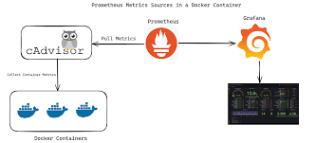
Monitoring Architecture Diagram

Slide 18
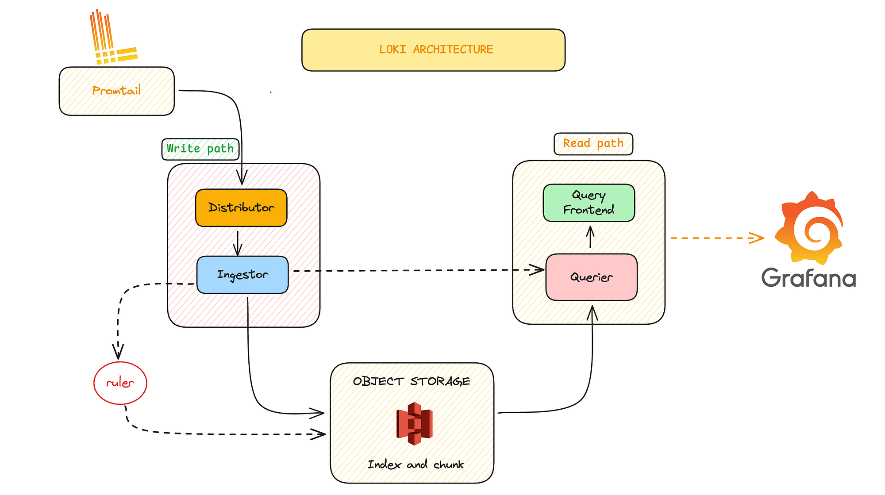
Logging Architecture Diagram

Slide 19
Benefits of Unified Monitoring & Logging
02
04
Faster troubleshooting and RCA
Scalable and open- source stack
01
03
Single- pane observability (Metrics + Logs)
Correlate spikes in metrics with logs

Slide 20
Summary
Understand what and why to monitor in containers
Leverage Prometheus for metrics
Use Grafana for powerful visualization
Centralized logging improves traceability
Combine metrics and logs for full observability
Summary

Slide 21
Discussion & Q/A
Let’s discuss your current Docker monitoring setup.

Slide 22
Thanks
Karthikeyan Vaiyapuri

